Slide 1
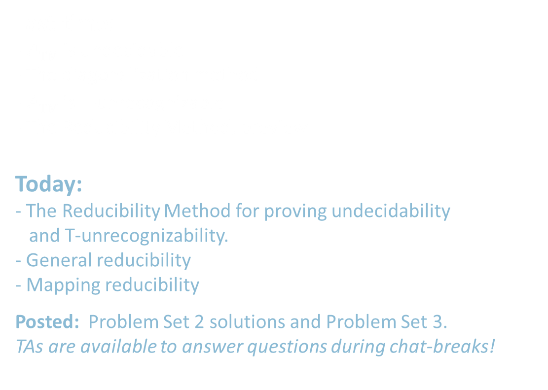
18.404/6.840 Lecture 9
Last time:
- $A\text{TM}$ is undecidable
- The diagonalization method
- $\overline{A\text{TM}}$ is T-unrecognizable
- The Reducibility Method, preview
Today:
- The Reducibility Method for proving undecidability
and T-unrecognizability.
- General reducibility
- Mapping reducibility
Posted: Problem Set 2 solutions and Problem Set 3.
TAs are available to answer questions during chat-breaks!

Slide 2

The Reducibility Method
If we know that some problem (say $A\text{TM}$) is undecidable,
we can use that to show other problems are undecidable.
Defn: $HALT\text{TM}$ $=\left\{〈M,w〉\right| M$halts on input $w\}$
Recall Theorem: $HALT\text{TM}$ is undecidable
Proof by contradiction, showing that $A\text{TM}$ is reducible to $HALT\text{TM}$:
Assume that $HALT\text{TM}$ is decidable and show that $A\text{TM}$ is decidable (false!).
Let TM $R$ decide $HALT\text{TM}$.
Construct TM $S$ deciding $A\text{TM}$.
$S=$ “On input $〈M,w〉$
1. Use $R$ to test if $M$ on $w$ halts. If not, reject.
2. Simulate $M$ on $w$ until it halts (as guaranteed by $R$).
3. If $M$ has accepted then accept.
If $M$ has rejected then reject.
TM $S$ decides $A\text{TM}$, a contradiction. Therefore $HALT\text{TM}$ is undecidable.

Slide 3

Reducibility – Concept
If we have two languages (or problems) $A$ and $B$, then
$A$ is reducible to $B$ means that we can use $B$ to solve $A$.
Example 1: Measuring the area of a rectangle
is reducible to measuring the lengths of its sides.
Example 2: We showed that $A\text{NFA}$is reducible to $A\text{DFA}$ .
Example 3: From Pset 2, PUSHER is reducible to $E\text{CFG}$.
(Idea- Convert push states to accept states.)
If $A$ is reducible to $B$ then solving $B$ gives a solution to $A$.
- then $B$ is easy $→$ $A$ is easy.
- then $A$ is hard $→$ $B$ is hard.
this is the form we will use
Check-in 9.1
Is Biology reducible to Physics?
Yes, all aspects of the physical world may be explained in terms of Physics, at least in principle.
No, some things in the world, maybe life, the brain, or consciousness,
are beyond the realm pf Physics.
I’m on the fence on this question!
Check-in 9.1

Slide 4



$E\text{TM}$ is undecidable
Let $E\text{TM}$ $=\{〈M〉| M$ is a TM and $L\left(M\right)=∅ \}$
Theorem: $E\text{TM}$ is undecidable
Proof by contradiction. Show that $A\text{TM}$ is reducible to $E\text{TM}$.
Assume that $E\text{TM}$ is decidable and show that $A\text{TM}$ is decidable (false!).
Let TM $R$ decide $E\text{TM}$.
Construct TM $S$ deciding $A\text{TM}$.
$S=$ “On input $〈M,w〉$
1. Transform $M$ to new TM $M_{w}=$ “On input $x$
1. If $x≠w$, reject.
2. else run $M$ on $w$
3. Accept if $M$ accepts.”
2. Use $R$ to test whether $L(M_{w}) =∅$
3. If YES [so $M$ rejects $w$] then reject.
If NO [so $M$ accepts $w$] then accept.
$M_{w}$ works like $M$ except that it
always rejects strings $x$ where $x≠w$.
So $L\left(M_{w}\right)=\left\{\begin{aligned}\left\{w\right\} \text{if} M accepts w \\ ∅ \text{if} M rejects w\end{aligned}\right.$

Slide 5








Mapping Reducibility
Defn: Function $f:Σ^{∗}→Σ^{∗}$ is computable if there is a TM $F$
where$F$ on input $w$ halts with $f(w)$ on its tape, for all strings $w$.
Defn: $A$ is mapping-reducible to $B$ ($A≤_{m}B$) if there is
a computable function $f$ where $w∈A$ iff $f\left(w\right)∈B$.
$$w$$
$$f\left(w\right)$$
$$A$$
$$B$$
$$f$$
Example: $A\text{TM}$ $≤_{m}\overline{E\text{TM}}$
The computable reduction function $f$ is $f(〈M,w〉$) = $〈M_{w}〉$
Because $〈M,w〉∈A\text{TM}$ iff $〈M_{w}〉∈\overline{E\text{TM}}$
( $M$ accepts $w$ iff $L\left(〈M_{w}〉\right)≠∅$ )
Recall TM $M_{w}=$ “On input $x$
1. If $x≠w$, reject.
2. else run $M$ on $w$
3. Accept if $M$ accepts.”

Slide 6

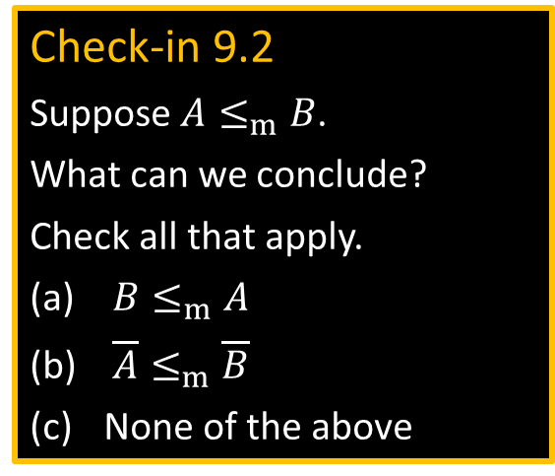



Mapping Reductions - properties
Theorem: If $A≤_{m}B$ and $B$ is decidable then so is $A$
Proof: Say TM $R$ decides $B$.
Construct TM $S$ deciding $A$:
$S=$ “On input $w$
1. Compute $f(w)$
2. Run $R$ on $f(w)$ to test if $f\left(w\right)∈B$
3. If $R$ halts then output same result.”
Corollary: If $A≤_{m}B$ and $A$ is undecidable then so is $B$
Theorem: If $A≤_{m}B$ and $B$ is T-recognizable then so is $A$
Proof: Same as above.
Corollary: If $A≤_{m}B$ and $A$ is T-unrecognizable then so is $B$
$$A$$
$$f$$
$$B$$
Check-in 9.2
Suppose $A≤_{m}B$.
What can we conclude?
Check all that apply.
$B≤_{m}A$
$\overline{A}≤_{m}\overline{B}$
None of the above
Check-in 9.2

Slide 7


Slide 8






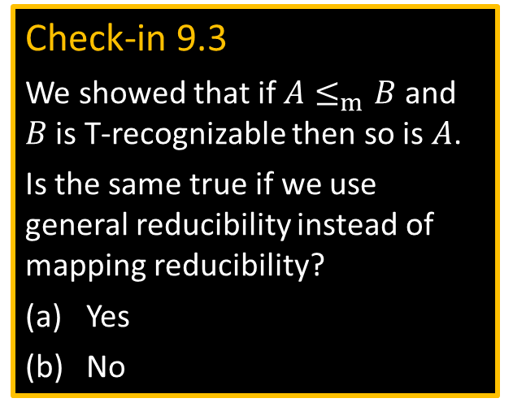
Mapping vs General Reducibility
Mapping Reducibility of $A$ to $B$: Translate $A$-questions to $B$-questions.
- A special type of reducibility
- Useful to prove T-unrecognizability
(General) Reducibility of $A$ to $B$: Use $B$ solver to solve $A$.
- May be conceptually simpler
- Useful to prove undecidability
Noteworthy difference:
- $A$ is reducible to $\overline{A}$
- $A$ may not be mapping reducible to $\overline{A}$.
For example $\overline{A\text{TM}}≰_{m}$ $A\text{TM}$
$$A$$
$$f$$
$$B$$
$A$ solver
Check-in 9.3
We showed that if $A≤_{m}B$and $B$ is T-recognizable then so is $A$.
Is the same true if we use general reducibility instead of mapping reducibility?
Yes
No
$B$ solver
Check-in 9.3

Slide 9
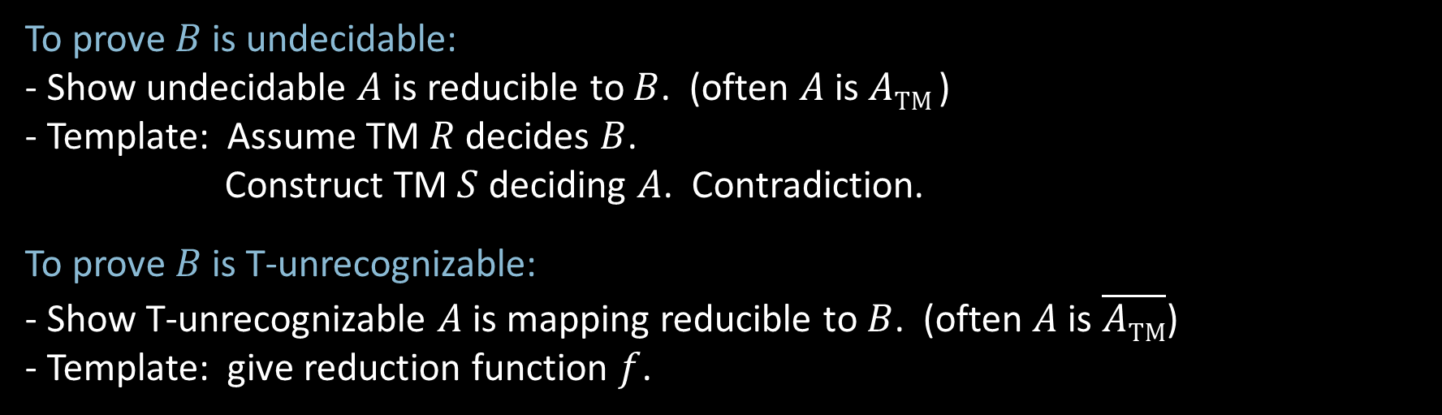
Reducibility – Templates
To prove $B$ is undecidable:
- Show undecidable $A$ is reducible to $B$. (often $A$ is $A\text{TM}$)
- Template: Assume TM $R$ decides $B$.
Construct TM $S$ deciding $A$. Contradiction.
To prove $B$ is T-unrecognizable:
- Show T-unrecognizable $A$ is mapping reducible to $B$. (often $A$ is $\overline{A\text{TM}}$)
- Template: give reduction function $f$.

Slide 10






$E\text{TM}$ is T-unrecognizable
Recall $E\text{TM}$ $=\{〈M〉| M$ is a TM and $L\left(M\right)=∅ \}$
Theorem: $E\text{TM}$ is T-unrecognizable
Proof: Show $\overline{A\text{TM}} ≤_{m}E\text{TM}$
Reduction function: $f\left(〈M,w〉\right)=〈M_{w}〉$
Explanation: $〈M,w〉∈\overline{A\text{TM}}$ iff $〈M_{w}〉∈E\text{TM}$
$M$ rejects $w$ iff $L\left(〈M_{w}〉\right)=∅$
Recall TM $M_{w}=$ “On input $x$
1. If $x≠w$, reject.
2. else run $M$ on $w$
3. Accept if $M$ accepts.”
$$\overline{A\text{TM}}$$
$$f$$
$$E\text{TM}$$

Slide 11



$EQ\text{TM}$ and $\overline{EQ\text{TM}}$ are T-unrecognizable
$EQ\text{TM}=\left\{〈M_{1}, M_{2}〉\right|{ M}_{1}$ and $M_{2}$ are TMs and $L\left(M_{1}\right)=L(M_{2}) \}$
Theorem: Both $EQ\text{TM}$ and $\overline{EQ\text{TM}}$ are T-unrecognizable
Proof: (1) $\overline{A\text{TM}}$ $≤_{m}$ $EQ\text{TM}$
(2) $\overline{A\text{TM}}$ $≤_{m}$ $\overline{EQ\text{TM}}$
For any $w$ let $T_{w}=$“On input $x$
1. Ignore $x$.
2. Simulate $M$ on $w$.”
Here we give $f$which maps $\overline{A\text{TM}}$ problems (of the form $〈M,w〉$)
to $EQ\text{TM}$ problems (of the form $〈T_{1},T_{2}〉$).
$f\left(〈M,w〉\right)=〈T_{w}, T_{\text{reject}}〉$ $T_{\text{reject}}$ is a TM that always rejects.
(2) Similarly $f\left(〈M,w〉\right)=〈T_{w}, T_{\text{accept} }〉$ $T_{\text{accept} }$ always accepts.
$T_{w}$ acts on all inputs the way $M$ acts on $w$.

Slide 12

Reducibility terminology
Why do we use the term “reduce”?
When we reduce $A$ to $B$, we show how to solve $A$ by using $B$
and conclude that $A$ is no harder than $B$. (suggests the $≤_{m}$ notation)
Possibility 1: We bring $A$’s difficulty down to $B$’s difficulty.
Possibility 2: We bring $B$’s difficulty up to $A$’s difficulty.

Slide 13

Quick review of today
Introduced The Reducibility Method to prove undecidability and T-unrecognizability.
Defined mapping reducibility as a type of reducibility.
$E\text{TM}$ is undecidable.
$E\text{TM}$ is T-unrecognizable.
$EQ\text{TM}$ and $\overline{EQ\text{TM}}$ are T-unrecognizable.

